Slide 1
Primo VE NDE UI:
What’s Next?
April 15, 2026
Notes:
Hello, everyone! My name is Jessica Gibson, and on behalf of the CARLI Discovery Primo VE Committee, I’d like to welcome you to this session on Primo VE NDE UI and What’s Next?!

Slide 2
Agenda
Overview of the Primo VE NDE
Some Frequently Asked Questions
Report from CARLI on the testing and status of consortial features for I-Share
Highlights of new features in NDE UI
Report on CARLI Discovery Primo VE Committee activities
Open Discussion (not recorded)
Notes:
At the session today, we will start with an overview of Primo VE NDE, talk through some Frequently Asked Questions, give a brief report on CARLI’s testing ongoing of consortial features for I-Share libraries, look at some of the new features in NDE UI, and hear a report on the Committee’s ongoing activities. At that point we will stop the recording and have time for open and honest discussion.

Slide 3
What is Primo VE NDE?
NDE = Next Discovery Experience
Four components:
  New User Interface (UI) that will replace Primo VE Views currently used
  More integration of Linked Open Data in the Primo interface
  AI-based Research Assistant in the Primo interface
  New user engagement analytics tool for Primo called Mixpanel
Notes:
So, What IS Primo VE NDE? We need to make sure we are all starting from the same place of understanding.
NDE stands for “Next Discovery Experience”, and Ex Libris, the vendor of the Alma and Primo software, has been working on this project for some time now.
NDE consists of four components: the New User Interface or ”UI” that will replace the Primo VE View currently in use, more integrated Linked Open Data features in the discovery interface, the AI-based Primo Research Assistant, and a new analytics tool for discovery called Mixpanel.
Ex Libris has already introduced integrations with Linked Open Data and the Research Assistant in Primo VE. They will continue to be available in NDE UI and development may continue there.
It is also important to note that there are no additional costs associated with any of the Next Discovery Experience components; they are simply the progression of the software that we already contract with Ex Libris for.
Our focus today will be on the NDE User Interface or UI.

Slide 4
When can libraries access NDE UI?
All customers have access to Primo NDE UI now.
Libraries can create a test NDE View for testing and planning alongside their existing “production” Primo VE View.
  I-Share libraries should not “Go Live” with NDE UI until CARLI has announced that all consortial functions are working.
If this is new information to you and/or you haven’t started yet, don’t panic! You have time…
Notes:
On to our frequently asked questions!
You may be wondering, when can libraries see or access or try this NDE UI?
The good news is that it is available to all libraries now for testing and planning! However, I-Share libraries should not “go live” with NDE UI until CARLI has announced that all consortial functions are working as expected. There are some things currently not working that we will touch on in an upcoming slide.
It is good news that we can all get our hands on it now, but, if this is all new to you, or you had heard about it but your library hasn’t started to think about it yet, please Do Not Panic. There is plenty of time before your library will have to switch to NDE UI.

Slide 5
When will the switch to NDE UI occur?
Ex Libris has announced that all customers must move to NDE UI by January 2028.
Each I-Share library can decide when to make the switch between July 2026 and January 2028.
  I-Share libraries should not “Go Live” with NDE UI until CARLI has announced that all consortial functions are working as expected.
I-Share libraries can decide when they will implement NDE UI based on their own local needs and resources.
I-Share libraries will not all have to switch at the same time.
Notes:
The switch to the NDE UI will need to occur sometime before January 2028. Ex Libris has declared that they will no longer support the current Primo VE Views at that time.
After CARLI is sure that all consortial functionality is working expected, I-Share libraries will be able to decide when to implement NDE UI based on your local needs and resources, and libraries will not be forced to switch all at the same time. We’re hoping that window will start in July 2026, but we think that summer 2027 is a perfectly good target date for many I-Share Libraries to aim for.

Slide 6
Can CARLI assist my library to implement NDE UI?
Yes, CARLI staff can assist libraries with the implementation of NDE UI, if needed.
CARLI will send out a survey to all I-Share Libraries asking for each library’s tentative plans and target “go live” date. Answers to this survey are non-binding.
  Survey will be sent to all I-Share Liaisons; the Liaison may pass the survey on to someone else responsible for Primo at their library as needed.
  One submission per library, please.
  Due June 6, 2026.
Notes:
Making the switch to NDE UI will include configuration and set up, evaluation of new features, and look-and-feel customization. CARLI is here to assist your library with the implementation of NDE UI, if needed. To help us understand your needs and plans, CARLI will be sending I-Share Liaisons a link to a survey to fill out by June 6, 2026 answering a few short questions about your library’s plans for Primo VE NDE UI and your target “go live” date.
Answers to this CARLI survey are totally non-binding; we simply need to get an idea of when I-Share libraries think that they will switch so that we can provide the right information and support. There are other similar consortia in the US that are planning to switch all of their libraries to Primo NDE UI at the same time, but we did not feel that that model would work for I-Share libraries and didn’t want to enforce a timeline like that.
Note that beyond the technical configuration and set up, there will be additional work at your library in terms of your local documentation and instruction information, so please be sure to discuss your plans with other staff at your library who will be involved in that other work!

Slide 7
Do libraries have to switch to NDE UI?
Yes. Moving to NDE UI is not optional.
Benefits
  “new, sleek, intuitive user interface” –Ex Libris
  Improved Accessibility
  According to the Primo Roadmap (Ex Libris): “UI enhancements and non-critical fixes will be applied to the NDE UI rather than to the original UI. This prioritization ensures that efforts are focused on the interface that will serve all Primo VE customers going forward.”
Notes:
You may be thinking, this sounds like a lot of work! Do we really have to do this? The answer is Yes, moving to NDE UI is required. However, keep in mind that there will be benefits to this switch including an updated interface, improved accessibility, and the fact that because Ex Libris will no longer support Primo VE Views as we know them today, they will stop developing any enhancements for it. In the end, this is the natural evolution of the software to its next iteration.

Slide 8
Can libraries test and make changes to NDE UI before going live?
Yes, this is strongly encouraged!
You can “Duplicate” your existing Primo VE View.
The current Primo VE View interface and the NDE UI View interface can exist side-by-side.
Libraries can present the NDE UI as a “beta” interface to users in addition to the current UI.
You may have more than one NDE UI View for testing.
Notes:
Now that you are (hopefully) on board and maybe even a little bit excited about the possibilities, you may be wondering if you can test things out? Absolutely! Testing is highly encouraged! It is very easy to Duplicate your existing Primo VE View and make an NDE UI View, and in a couple of minutes, Andrew will demonstrate how easy it is to Duplicate a View.
Another thing to keep in mind is that your current Primo VE View and the NDE UI View interfaces can exist side-by-side both for internal testing, and, should your library choose to do so, you could even release the NDE UI interface as a “beta” to your users for a time while you continue tweaking or while you’re wait for Ex Libris to fix some bugs or improve it further.
You may also have more than one NDE UI View for testing if needed.

Slide 9
Will the URLs, permalinks, and search boxes change in NDE UI?
During testing, before “go live”, such links will necessarily be different.
Once your library has gone live with NDE UI as your primary Primo interface, all traffic, including URLs, permalinks, and searches from external search boxes, will be automatically redirected to the NDE UI.
Notes:
How will URLs, permalinks, and search boxes change with NDE UI? During your testing, or if you should decide to release NDE UI as a beta with the current Primo VE, the links will necessarily be different, However, once your library “Goes live” with NDE UI, all traffic and URL and search boxes and permalinks from Primo VE will automatically redirect to the NDE UI. Ex Libris will take care of that redirection behind the scenes, so you do NOT have to worry about going through your website or documentation to update a lot of links, though you may choose to update them if you prefer.

Slide 10
Can we copy configurations from the current View to NDE UI?
Yes, if you “Duplicate” your existing Primo VE View, most configurations will be copied from that View into the new NDE UI View.
  There are a few exceptions due to new configuration options
There are also several new configuration options available only in NDE UI that you will want to evaluate and make decisions about for your library.
However, you cannot copy any customization made with the Customization Package in the current Primo VE View to NDE UI.
Notes:
In more good news, if you Duplicate an existing Primo VE View to an NDE UI View, it will automatically copy most of the existing configurations to the new NDE UI View. There are a few exceptions due to configuration changes, and there are several new configuration options in NDE UI that you’ll want to evaluate and make decisions about for your library.
This applies to the settings in Alma Configuration in the Discovery View Configuration tabs, but not for the Customization Package itself...

Slide 11
How will NDE UI affect the Primo Customization Package?
Current Primo VE Customization Package that allows for custom images, colors, the Primo VE HTML-based homepage, CSS, and JavaScript add-ons cannot be migrated “as is” to NDE UI.
Some previous customizations may be obsolete due to new Configuration options:
  Color theme options available “to help ensure accessibility through proper color contrast, visible focus indicators, and consistent styling”
  Landing Page customization within configuration (coming in May 2026 release)
  Option to collapse Other I-Share Libraries section now in configuration
  Select Vendor Add-ons
Custom colors, CSS, and JavaScript are still possible in a new Customization Package for NDE UI.
Note: there is no Primo Studio for NDE UI. According to EXL, most functionality has been transferred to Alma configuration.
Notes:
If your library has applied advanced customizations to Primo VE using the Customization Package for custom colors, images, the HTML-based homepage, CSS, or JavaScript add-ons, this existing package can’t be used in NDE UI. The underlying Angular framework has changed significantly with NDE UI so it simply will not work “as is”. A new Customization Package will need to be created if needed.
That said, it is important to note that some things that previously required the Customization Package will not in NDE UI. They will now offer the ability to select a Color Theme to help ensure proper accessibility, the Landing Page information will become editable in Alma Configuration in the May 2026 release, the option to collapse the Other I-Share Libraries section will be a config option, and some vendor add-ons as well.
And finally, there is no more Primo Studio tool with NDE UI.

Slide 12
CARLI Testing of NDE UI
Three issues of major concern for I-Share Libraries so far:
Automatic Item Availability Checking in the I-Share Request Form does not work. Tentatively scheduled to be fixed in July 2026 release.
Requests display twice in the “All Institution” view of the user’s library account.
Ability for users to place requests for items that are not available. Request is submitted by Primo and immediately cancelled by Alma.
More details about these and other information posted on CARLI’s Primo VE NDE UI for I-Share webpage.
Notes:
CARLI staff have been testing the NDE UI with a particular focus on consortial features, especially requesting. We have identified three issues of major concern for I-Share libraries thus far:
Most I-Share libraries have enabled Automatic Item Availability Checking in the I-Share Request Form. This feature automatically checks the network to determine if there is an item available to a user to request before allowing them to place that I-Share request. That feature is currently not working properly, and it is presenting an inappropriate and unhelpful error message to the user as a result. CARLI has heard from Ex Libris that this is tentatively scheduled to be fixed in the July 2026 release, but that date is subject to change.
Another issue we have seen is that I-Share requests in the new “All Institutions” view of the user’s library account are displaying twice. This may cause the user to think they have requested it twice and they may cancel the request as a result. We’re working with Ex Libris on that as they have been unable to reproduce the issue in their environments thus far.
We are investigating reports by member of the Discovery Primo VE Committee that some items that should not be requestable are requestable in Primo NDE UI, and then immediately canceled by Alma. We are looking into this further.
More details about these are currently posted on CARLI’s Primo VE NDE UI for I-Share webpage, and we’ll continue to post additional issues as we identify and test them.

Slide 13
New community Basecamp project for CARLI libraries implementing NDE UI
Goal is to allow CARLI libraries to ask questions and share information with each other during their NDE UI implementations.
Includes a Message Board for Q&A and place to share Documents/Files.
Members include: CARLI staff, the members CARLI Discovery Primo VE Committee, and staff from any CARLI library using Primo
More information coming in an email to various CARLI email lists soon!
To be added to the Basecamp, simply send an email to support@carli.illinois.edu with the name(s) and email address(es) of staff who want to join.
Notes:
In addition to the information on that CARLI webpage, CARLI and the CARLI Discovery Primo VE Committee are pleased to announce a new community resource in the form of a Basecamp Project for CARLI libraries working on implementing the NDE UI.
This Basecamp project is an experiment to try to facilitate communication and information-sharing among CARLI libraries during their implementation of NDE UI. The Basecamp project will be a resource for asking questions and sharing answers and experiences.
CARLI staff and members of the Committee will be present and have been pre-populating the project with some information during our early testing.
You’ll need to email us at support@carli.Illinois.edu to be added to the Basecamp. You can plan to only read it, you don’t have post, though we hope that you’ll consider sharing your questions and experiences with other libraries as appropriate.
Next, I’ll pass things over to committee member Andrew Bolongee for a brief, live demonstration of the NDE UI and more information on what the Discover Primo VE Committee has been doing in Basecamp!

Slide 14
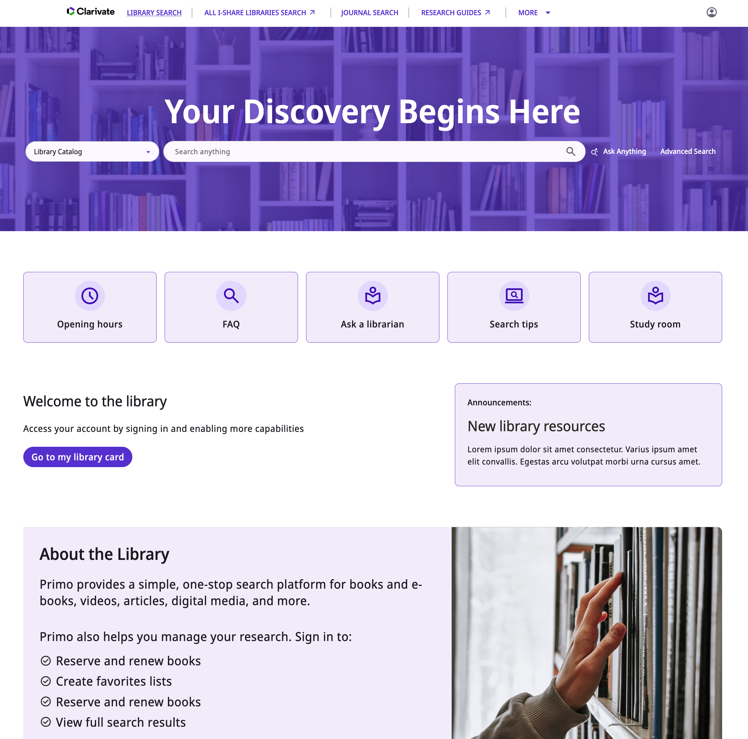
Primo VE NDE UI live demo
Notes:
Andrew Belongea performs a live demo of Primo VE NDE UI showing some highlights and features.

Slide 15
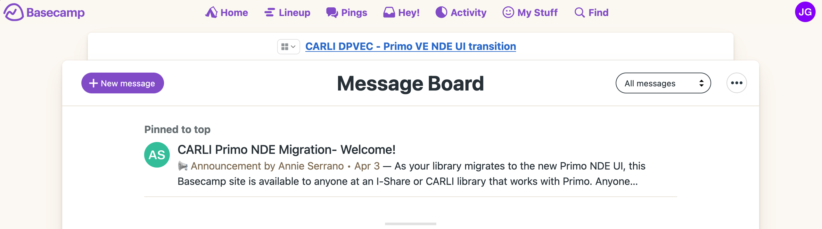
CARLI Basecamp Project first look
Notes:
Andrew Belongea shows the contents of the Basecamp and briefly discusses the work done to date by the CARLI Discovery Primo VE Committee.

Slide 16
Ex Libris Documentation, Future Development and Known Issues
Next Discovery Experience User Interface
Overview of the NDE Interface and Configuration
Available Features, Functionality and Release Plan for NDE UI – future development
Primo VE Roadmap Highlights: 2026-2027 – future development
Ex Libris Known Issues list - NDE issues – the number of known issues show that NDE UI is still a work in progress
NDE UI: All Resources in One Place – links to every NDE-related recording and document from EXL

Slide 17
Discussion
(Not Recorded)

